Slide 1
What does 'fairness' mean in (data protection) law?
Damian Clifford, Jef Ausloos and Laurens Naudts
Notes:
damian.clifford@anu.edu.au
j.ausloos@uva.nl
laurens.naudts@kuleuven.be

Slide 2
1. Introduction – Fairness, discrimination and ethics

Slide 3
Justice, Fairness and Equality
Political Philosophy: explores the interplay/alignment between legal, economic and civil aspects of social life, as they determine the burdens and benefits that members within society carry, can be best adjusted to the interest of those individuals or groups of individuals.
Justice: Addresses what should be done when the desires or interests of people oppose one another and cannot all be fully satisfied. exploration on how society should be structured: they debate the preferred distribution of the opportunities, formulating the principles that serve as moral guidance.
Equality: A guiding moral principle for justice, which provides substantive meaning to the formal notion that like situations should be treated alike, and different situations differently.
Fairness: Elusive concept that is mainly called into question where there is a distribution of benefits and burdens.

Slide 4




Justice
Bob: “I am poor and have no toys of my own. The flute would give me something to play with.”
Anne: “I am the only one who can play this instrument. It would be quite unjust to deny the flute to the one who can actually play it!”
Carla: “I have been working months on this flute, but then these expropriators came to grab the flute away from me!”
Amartya Sen, The Idea of Justice (2009)
Notes:
In the debate in profiling – you have various values at stake, liberty and autonomy are one of them, and equality and non-discrimination another. Yet, if you look at theories of justice, they do not hold both theories at the same regard – a balancing exercise must be made. Hence, when you translate these discussions onto the algorithmic environment, and one opts for both – it might be that in the future, these values clash, and that the solutions proposed favour one over the other.
Second, you have a multitude of fairness approaches – and if there is no consensus, and to a certain extent this can be alleviated by taking the law as the predominant governing instrument of what should not happen, or human rights as consensus, but
The societal effects of automated decision-making practices, and our intuitions regarding discrimination, might be best approached through egalitarian theories. On the level of the individual, certain toxic effects associated with algorithmic decision-making, such as profiling, might perhaps benefit from an articulation utilising notions such as autonomy and individual freedom. In political philosophy however, the relationship between liberty on the one hand and equality on the other is tenuous. Ensuring equality and preserving autonomy are often perceived as deserving of equal consideration in algorithmic debates. Nevertheless, an approach which focuses on the power of individuals through a notion of liberty, might in fact result in more inequalities. In other words, trade-offs and conflicts might follow due to a chosen fairness criterion, even though such conflict might not be immediately perceived. Discussions concerning the effects of machine learning on equality and autonomy, if simply performed in isolation of one another, might forego the relationship that exists between these notions from a political philosophical perspective. If a given value is preferred for evaluating forms of automated decision-making, maybe it also inherently entails an acceptance of that value overall, and in turn, the consequences it has in the associated societal realm.
But also from a legal perspective, if we do want to avoid certain decision-making practices, we might need certain information, hence trade-off between privacy v. equality need to be

Slide 5
Fairness
Broad in Application
Many different things are said to be fair or unfair, e.g. persons, agents, institutions, data processing, etc.
Complex in Structure
Distributive (Fair Share)
Procedural (Fair Treatment) (e.g. Data Protection)
General versus Individualized (e.g. rule of law)
Morally Deep in Content
Statements concerning fairness are underpinned by strong reasons.
// Impartiality, equality, freedom of bias, legitimacy, correct and proper
Rawls: Fairness as prior and requirement for Justice?
Notes:
Ryan: “I do not believe that there is any very persuasive way of tidying up the many considerations that we ordinarily adduce when discussing the fairness of a result.”

Slide 6
Equality
Moral Equality:
Individuals should be treated as equals, i.e. with equal concern and respect (Egalitarian Plateau, Dworkin)
Social Equality/Egalitarian Justice:
Equality of What? What aspect(s) of a person's condition should count in a fundamental way for the egalitarian, i.e. what is the currency of equality (G.A. Cohen)?
The Ethics of Discrimination:
What is Discrimination?
What makes it wrong?
What should be done about wrongful discrimination
Harm based/Consequential Accounts
Non-harm based/Non-consequential Accounts
Notes:
This does not mean that all people should be treated equally, or that all people should or deserve the same, but rather that when treating individuals, they should be treated with equal respect, worth and dignity

Slide 7
Specific characteristics, e.g. gender or ethnicity + Specific Contexts or Purposes, e.g. employment or provision of services
Fair/Unfair Differentiation?
Algorithmic Differentiation
Substantive European Non-Discrimination Law
Contexts and Purposes
Notes:
Of course there is a reason why the law focuses particularly on a narrow area of differentiaton, because we, as society have deemed these forms of discrimination as unfair, and we are quite confident in that the practices regulated within the law are unfair and therefore need
As algorithmic differentiation increases, so does the chance that these forms of differentiation are unfair, of course fair differentiation increases too, they are not communicating vessels
Human decision-making, but algorithms, when widely deployed can have a bigger impact.

Slide 8
Art. 14 - A Divergent Approach towards Differentiation Grounds
Engel/Rasmussen (1970’s) | Carson/Clift (2010) | Springett/Peterka (2010) | Molla Sali/Fabian (2018/2017) | Big Brother Watch (2018)
DG are Illustrative and not exhaustive, shown by the words "any ground such as“. The word "status" is wide enough to (seemingly) include other grounds. | DG based on identifiable, objective or personal characteristics, or “status”, by which persons or groups of persons are distinguishable. A distinction needs to be based on a “personal” characteristic, which does not need to be innate or inherent. | DG based on an innate characteristic which applies from birth, such as “sex”, “race” or “colour”. DG should be based on grounds analogous or similar to those in Art. 14 ECHR, which reflect personal choice as elements of someone’s personality or on grounds of personal features in respect of which no choice at all can be made. | DG based on an identifiable characteristic, or ‘status’, are capable of amounting to discrimination. “Status” has a wide meaning in its case-law, not limited to characteristics which are personal in the sense that they are innate or inherent | DG where differences in treatment can be explained in terms of personal characteristics. In casu geographic location is not a relevant difference in treatment for the purposes of Article 14 ECHR.
Notes:
following ‘grounds’, not captured by the non-exhaustive list provided, have been granted protection: disability, age, sexual orientation, fatherhood, marital status, membership of an organisation, military rank, parenthood of a child born out of wedlock, place of residence, health or any medical condition, former KGB officer status, retirees employed in certain categories of the public sector and detainees pending trial. Weller v Hungary App no 44399/05 (ECtHR 31 March 2009).
Petrov v Bulgaria App no 15197/02 (ECtHR 22 May 2008).
See inter alia: Danilenkov and Others v Russia App no 67336/01 (ECtHR, 30 July 2009) and Grande Oriente d’Italia di Palazzo Giustiniani v Italy App no 26740/02 (ECtHR 31 May 2007).
Engel (n 49).
Sommerfeld v Germany App no 31871/96 (ECtHR Grand Chamber, 8 July 2003); Sahin v Germany App no 30943/96 (ECtHR Grand Chamber, 8 July 2003).
Carson (n 52); Pichkur v Ukraine App no 10441/06 (ECtHR 7 November 2013).
Novuk and Others v Russia App no 31039/11 and others (ECtHR 15 March 2015).
Sidabras and Others v Lithuania App no 50421/08 and 56213/08 (ECtHR 23 June 2015).
Fabian (n 64).
Varnas v Lithuania App no 42615/06 (ECtHR, 9 July 2013) See also: Europäische Union, Europarat and Europäischer Gerichtshof für Menschenrechte (eds), Handbook on European Non-Discrimination Law (2018 edition, Publications Office of the European Union 2018) 224–225.

Slide 9
Fairness and Machine Learning
 | Parity (// Equality) | Preference (// Envy-freeness and Game Theory)
Treatment | Treatment Parity Counterfactuals Fairness (Kusner et al. 2017) | Preferred Treatment (Zafar et al. 2017)
Impact (Results) | Group Fairness (Feldman et al. 2014) Individual Fairness (Dwork et al. 2011, 2017) Equality of Opportunity (Hardt et al. 2016, Zafar et al. 2017) | Preferred Impact (Zafar et al. 2017)
Source: Gajane and Pechenizkiy (2017)
Examples of fairness notions in ML
Current Focus/Approach in both Policy and Design:
Fairness as Equality
Fairness as absence of bias
Bias towards sensitive attribute groups
Fairness as a means to address present injustices
Design-based solutions
Notes:
Refer also to paper of fairness berkman klein center

Slide 10
Articulation and Formalization of Fair Machine Learning
Fair Machine Learning Outcomes
Fair Machine Learning Procedures
Depends on perspective one takes:
Contractarian
Egalitarian
Strict Egalitarianism
Equality of (Initial) Opportunity
Equality of Welfare
Sufficientarianism
Prioritarianism (Parfit)
Capability Approach (Sen, Nussbaum)
Libertarian
Utilitarian
Data Protection Laws
Transparency
A formalized ‘fairness’ rule
Controlling the parameters within learning processes
Other Principles (Beauchamp, Childress):
Personal Autonomy/Identity
Beneficence
Nonmaleficence
Notes:
Process: can be for instance, determine or listen to the users how they feel about the procedure – not start from the outcome, but consider moral evaluations of the individuals that are subject to a decision.
Formal grounds, based appraoch, like is found in cases like Engel and Rasmussen I believe, would also allow new grounds to be brought before the court, for a case-by-case assessment.

Slide 11
In light of such uncertainty, algorithmic governance might be best served with a fluent concept like fairness, which, like the technology it seeks to assess, can be subject to a periodic re-evaluation.
Fairness in Data Protection has a meaning distinct from Fairness in Social Justice, but
Fair data processing, as we will see, could be interpreted in function, or in light, of social justice.

Slide 12
2. Fairness, Data Protection and the fair balancing of rights and interests in EU constitutional law

Slide 13
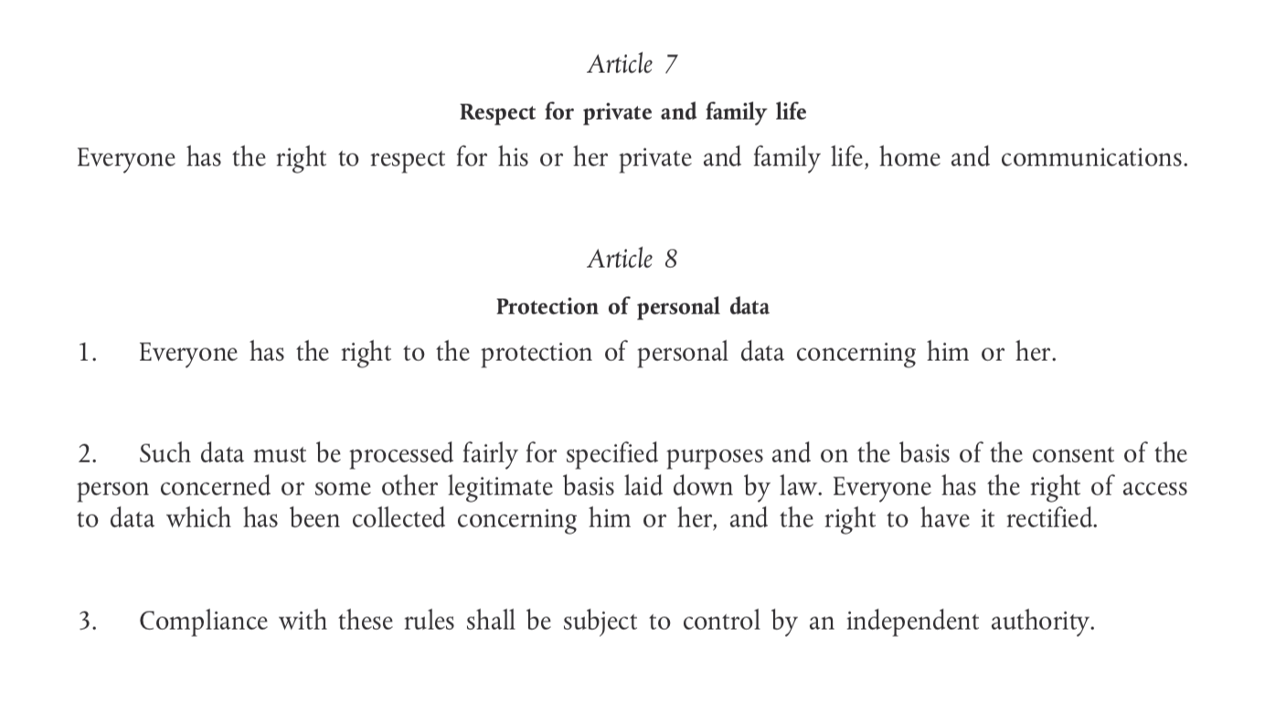
The Charter of Fundamental Rights of the European Union

Slide 14
Data protection fairness, the Charter and the ‘essence’ of the right to data protection
Limitations on rights and freedoms
Article 52(1) – ‘Any limitation on the exercise of the rights and freedoms recognised by this Charter must be provided for by law and respect the essence of those rights and freedoms. Subject to the principle of proportionality, limitations may be made only if they are necessary and genuinely meet objectives of general interest recognised by the Union or the need to protect the rights and freedoms of others.
What is the essence of the right to data protection?

Slide 15
What is the essence of the right to data protection?
Fuster and Gutwirth illustrate that there are 2 approaches:
Positions the right to data protection as substantially representing a prohibition on the processing of personal data subject to limitations,
Understands the right permissively as a series of rules applying to the processing of personal data without forbidding processing as such.
Approach 1 Article 8 Charter = Art. 8(1) Charter - (Art. 8(2) Charter + Art. 8(3))
Approach 2 Article 8 Charter = Art. 8(1) Charter + Art. 8(2) Charter + Art. 8(3)
Notes:
Gloria González Fuster and Serge Gutwirth, ‘Opening up Personal Data Protection: A Conceptual Controversy’ (2013) 29 Computer Law & Security Review 531.

Slide 16
What is the essence of the right to data protection?
Viewing data protection as a distinct right covering a broader scope of information, the GDPR can be positioned as a more effective mechanism for informational self-determination and personal development by fostering increased data subject control over their personal data through a variety of checks and balances (see Clifford and Ausloos).
Indeed Lynskey opines that individual control or informational self-determination can be understood to play the role of a normative anchor for the interpretation of the data protection framework.
Notes:
Damian Clifford and Jef Ausloos, ‘Data Protection and the Role of Fairness’ [2018] Yearbook of European Law 1.
See: Orla Lynskey, The Foundations of EU Data Protection Law (First, Oxford University Press 2016) 177–196.

Slide 17
But how does this manifest itself in the framework?

Slide 18
Key Provisions from the GDPR
Fairness and the data protection framework - A ‘core’ principle
Explicit and implicit role
Explicit – link to transparency and data collection
Implicit – Fair balancing in asymmetric relationships
However is this distinction really satisfactory?
More than just transparency involved
Far more than data collection

Slide 19
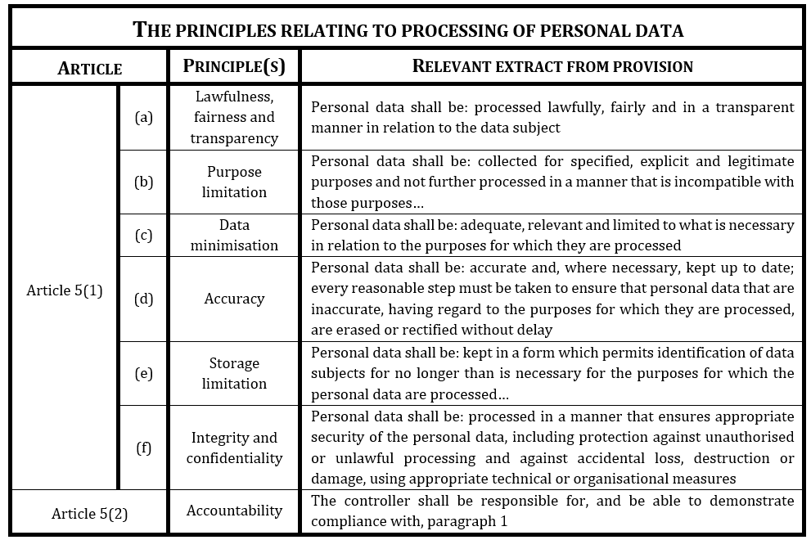
Key Provisions from the GDPR

Slide 20
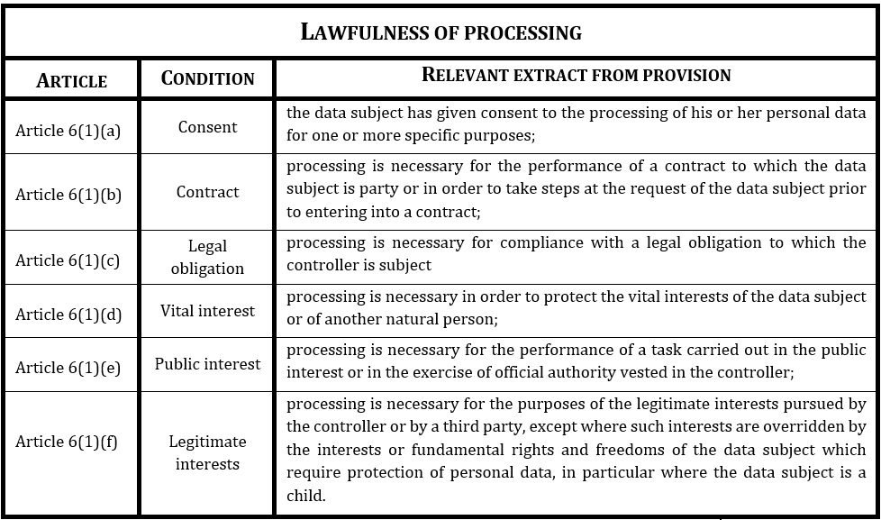
Key Provisions from the GDPR
The purpose, means and the interests at stake determine the applicability and suitability of these in a given context.
The requirement for transparent information, communication and modalities for the exercise of the rights of the data subject as specified in Article 12 GDPR and then further clarified in terms of the precise information to be included in Articles 13 and 14 GDPR.
Access Article 15
Rectification Article 16
Erasure Article 17
Restriction Article 18
Portability
Article 20
Object Article 21
AID-Profiling Article 22

Slide 21
Fairness in data protection is therefore a very broad notion so what does this mean in terms of the move towards AI ethics?

Slide 22
AI Ethics and Fairness
European Data Protection Supervisor (EDPS) opinion call for a move towards new digital ethics which notes that, ‘[d]ata protection principles have proven capable of safeguarding individuals and their privacy from the risks of irresponsible data processing. But today’s trends may require a completely fresh approach. So we are opening a new debate to what extent the application of the principles such as fairness and legitimacy is sufficient’.
But what does this separation between fairness as a legal principle and “ethics” mean?
As noted by Hijmans and Raab,
‘[…] it is often unclear what this ethical ‘turn’ amounts to, how it relates to legal requirements, and what practices it enjoins on (or forbids to) whom; moreover, what its proponents mean by ‘ethics’ is often not explained.’
Notes:
Hielke Hijmans and Charles D Raab, ‘Ethical Dimensions of the GDPR’ in Mark Cole and Franziska Boehm (eds), Commentary on the General Data Protection Regulation ((2018, Forthcoming) Edward Elgar 2018) 11 <https://papers.ssrn.com/abstract=3222677> 3.

Slide 23
AI Ethics and Fairness
Nemitz offers the GDPR as an example of AI regulation and it seems reasonable to conclude that legal requirements expressed in the GDPR should be delineated from broader ethical concerns which remain unexpressed or ambiguous in terms of the obligations and safeguards laid down therein in an abstract sense.
Here reference can be made to Floridi’s distinction between ‘hard’ and ‘soft’ ethics with the notion of hard ethics referring to ‘what makes or shapes the law’ and soft ethics to post-compliance ethics and what should be done ‘over and above the existing regulation, not against it, or despite its scope, or to change it, or to by-pass it (e.g. in terms of self-regulation).’
Notes:
Nemitz Paul, ‘Constitutional democracy and technology in the age of artificial intelligence’, 376 Philosophical Transactions of the Royal Society A: Mathematical, Physical and Engineering Sciences http://doi.org/10.1098/rsta.2018.0089
Luciano Floridi, ‘Soft Ethics and the Governance of the Digital’ (2018) 31 Philosophy & Technology 1, 4. See also: Luciano Floridi, ‘Soft Ethics: Its Application to the General Data Protection Regulation and Its Dual Advantage’ (2018) 31 Philosophy & Technology 163.

Slide 24
AI Ethics and Fairness
Due to the broad role of fairness in the GDPR, one must therefore wonder how the separation of ethics and this principle via the EDPS’s positioning of the latter as a purely legal notion adds up.
Key takeaways
GDPR is a regulatory manifestation of ethical concerns. Within the operation of the Regulation there are clear rights and obligations which must be respected irrespective of broader ethical debates (i.e. soft ethics) but irrespective of this point these rights and obligations are grounded in ethics.
The grey areas that are left in the operation of the GDPR and more specifically, the fair balancing of rights and interests provide a role for soft ethical debates within the operation of the fairness principle in a particular context to determine the legality of a specific processing operation (i.e. fairness becomes the avenue through which such debates could be filtered into the Regulation).
Through such an understanding the fairness principle would obliged the adoption of ethical data practices and standardisation mechanisms which effectively incorporate broader socio-ethical based considerations in their operation. Of course this may be idealistic.
Notes:
Luciano Floridi, ‘Soft Ethics and the Governance of the Digital’ (2018) 31 Philosophy & Technology 1, 4. See also: Luciano Floridi, ‘Soft Ethics: Its Application to the General Data Protection Regulation and Its Dual Advantage’ (2018) 31 Philosophy & Technology 163.
European Data Protection Supervisor, ‘Towards a New Digital Ethics - Data, Dignity and Technology’ (EDPS 2015) Opinion 4/2015 14 <https://edps.europa.eu/sites/edp/files/publication/15-09-11_data_ethics_en.pdf> accessed 28 March 2017.

Slide 25
AI Ethics and Fairness
The various initiatives currently being taken at the EU and national level could be then made effective in the application of the GDPR or at least, in further specifying the greyness in the Regulation’s provisions.
Indeed, in this regard reference can be made to the guidelines produced by the High-Level Expert Group on Artificial Intelligence set up by the European Commission which appears to follow Floridi’s soft-hard ethics model and in essence, recognises the role of ethics as requiring debates that go beyond current legal requirements.
This suggestion does not help however, in the determination of what is ‘fair’ or ethical in a given circumstance and thus any attempts to decipher what such notions may mean in the application of the framework requires an understanding of how the term ethics is being conceived of in the policy debates.
In this regard, it is interesting to note that human dignity was the key driver for the EDPS’s engagement with ethics when Giovani Buttarelli proposed the insertion of an ethical claim into the data protection ecosystem, and this engagement with human dignity as an essential value seems to pervade the discussion on ethics.
Notes:
‘Ethics Guidelines for Trustworthy AI High-Level Expert Group on Artificial Intelligence’ (European Commission 2019) 6.
Hielke Hijmans and Charles D Raab, ‘Ethical Dimensions of the GDPR’ in Mark Cole and Franziska Boehm (eds), Commentary on the General Data Protection Regulation ((2018, Forthcoming) Edward Elgar 2018) 11 <https://papers.ssrn.com/abstract=3222677> 2.
‘Ethics Guidelines for Trustworthy AI High-Level Expert Group on Artificial Intelligence’ 10.

Slide 26
So is fairness a vehicle for AI ethics?
Yes

Slide 27
3. Case Study

Slide 28
Virtual assistant
IoEverything
A smart fridge

Slide 29
Do the activities come within the scope of the GDPR?

Slide 30
Key Provisions from the GDPR
Article 2(1). ‘This Regulation applies to the processing of personal data wholly or partly by automated means and to the processing other than by automated means of personal data which form part of a filing system or are intended to form part of a filing system.’
‘Processing’ is broadly defined in Article 4(2) GDPR as,
‘[…] any operation or set of operations which is performed on personal data or on sets of personal data, whether or not by automated means, such as collection, recording, organisation, structuring, storage, adaptation or alteration, retrieval, consultation, use, disclosure by transmission, dissemination or otherwise making available, alignment or combination, restriction, erasure or destruction’.
Personal data are defined in Article 4(1) GDPR as,
‘[…] any information relating to an identified or identifiable natural person (‘data subject’); an identifiable natural person is one who can be identified, directly or indirectly, in particular by reference to an identifier such as a name, an identification number, location data, an online identifier or to one or more factors specific to the physical, physiological, genetic, mental, economic, cultural or social identity of that natural person.’

Slide 31
Virtual assistant
IoEverything
A smart fridge

Slide 33
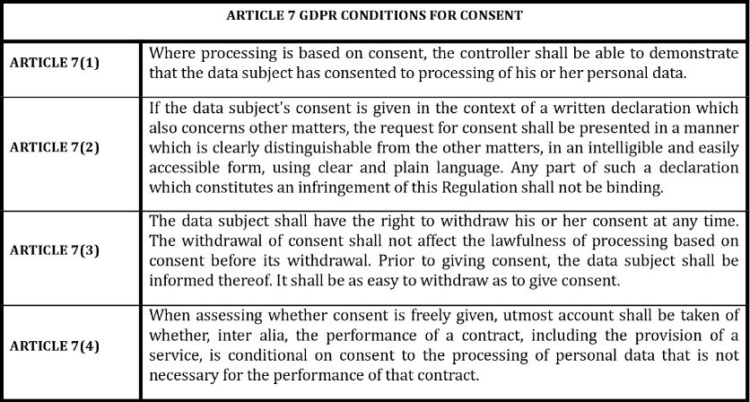

Slide 34
But can the 2 devices be placed in the same bracket? What might differentiate them?

Slide 35
Virtual assistant
IoEverything
A smart fridge

Slide 36
Any risk for either processing sensitive personal data as prohibited on Article 9(1) GDPR?

Slide 37
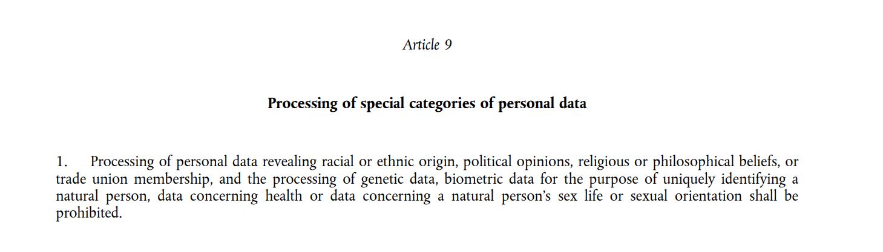

Slide 38
Virtual assistant
IoEverything
A smart fridge

Slide 39
What potential challenges does this raise for the smart assistant in terms of the conditions for lawful processing keeping in mind that in the home people may often have conversations on sensitive topics?

Slide 40
Virtual assistant
IoEverything
A smart fridge

Slide 41
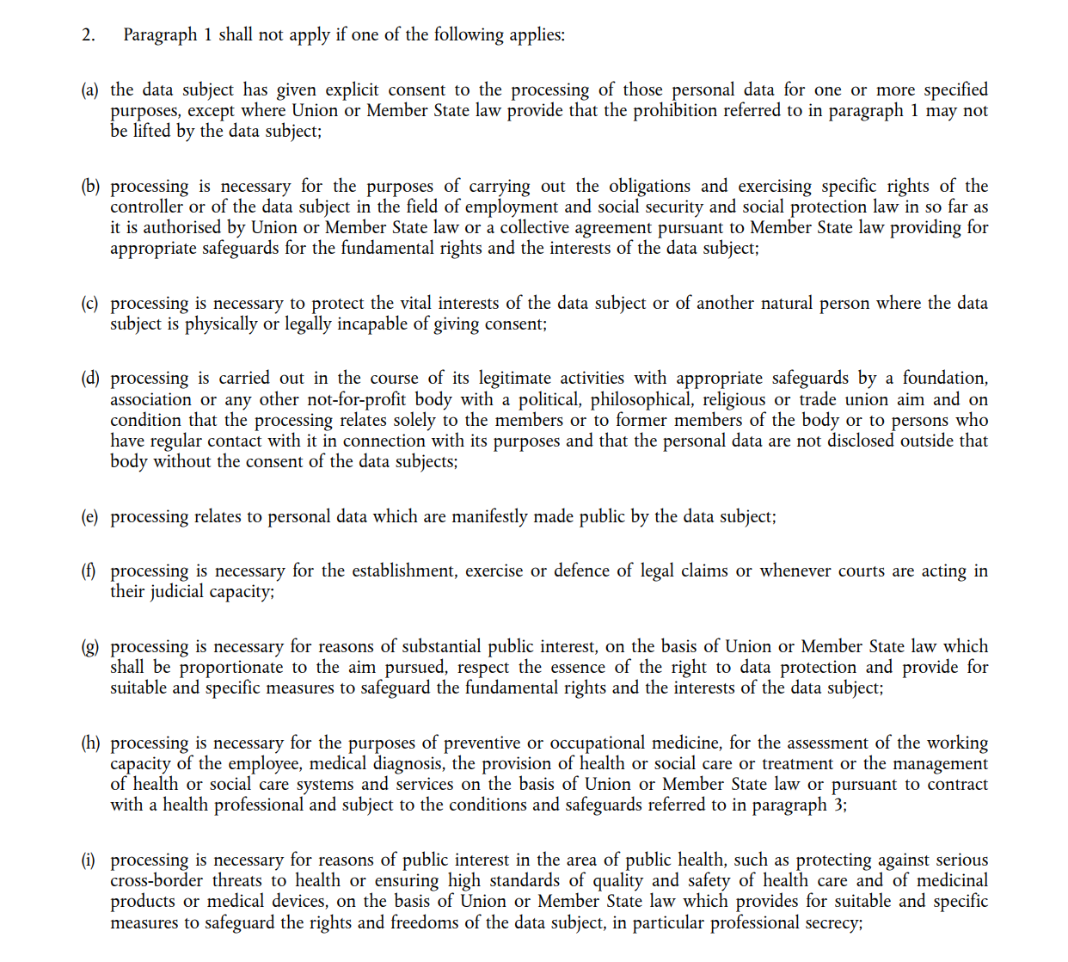

Slide 42
What about data subject rights? What challenges might arise with regard to the right of access and right to object?
Notes:
Who is exercising?
Scope of the rights?
Conflicts with other rights?
How granular can you go? Object only to use of location data (but not other data) for personalised ads?

Slide 43





Data Subject Right Modalities
Free of Charge
Time Limit
Form of Exercising
Form of Answer
Intelligible
Verification of Identity
$

Slide 44
Transparency and the Right of Access
GDPR Artt.13-14 & 15
Ex ante v ex post + push v pull
Central to data protection law from early start
Guarantees accountability/responsibility/compliance
Enables other data subject rights
Guarantees other legal rights

Slide 45
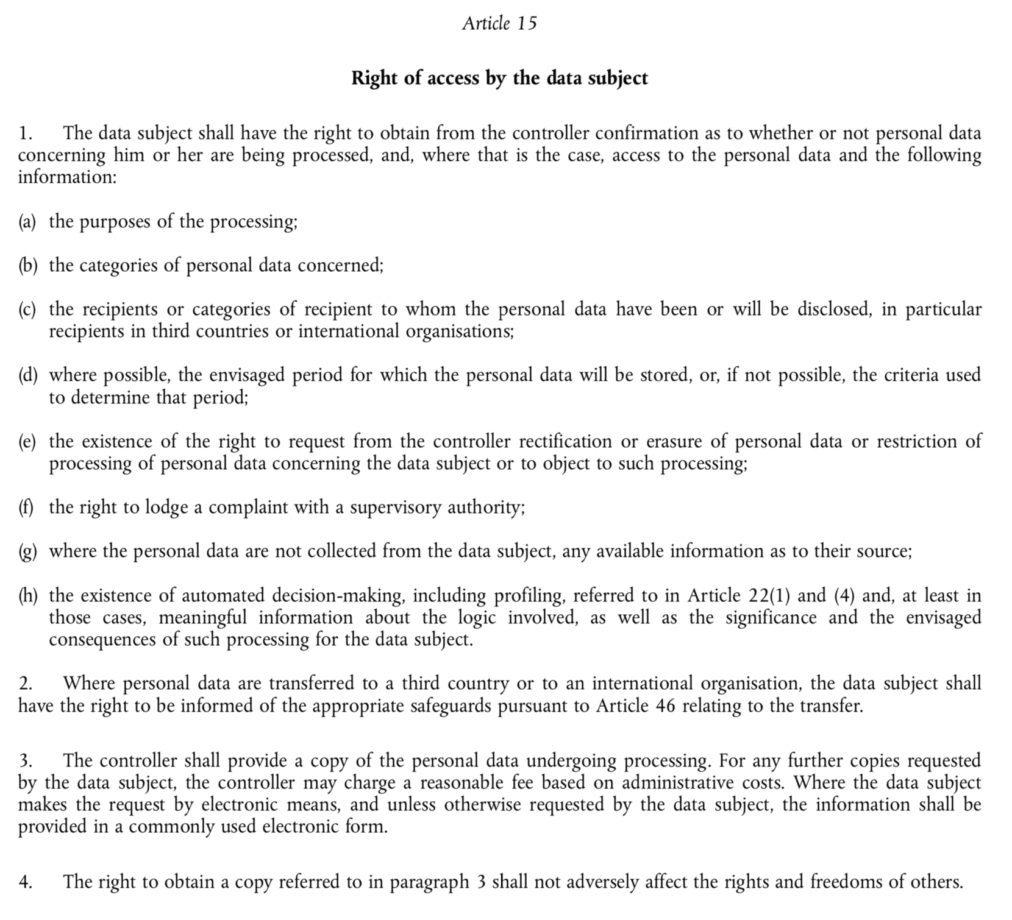

Slide 46
Virtual assistant
IoEverything
A smart fridge
Notes:
Right of Access v-a-v any of these actors?
What about conflicting rights/interests? How to resolve?
Quid Right of access versus Data Protection by Design (cf. Veale, Binns, Ausloos, 2018)? Cf Verification of identity issue.

Slide 47
Right to object (Art.21)
1. The data subject shall have the right to object, on grounds relating to his or her particular situation, at any time to processing of personal data concerning him or her which is based on point (e) or (f) of Article 6(1), including profiling based on those provisions. The controller shall no longer process the personal data unless the controller demonstrates compelling legitimate grounds for the processing which override the interests, rights and freedoms of the data subject or for the establishment, exercise or defence of legal claims.
2. Where personal data are processed for direct marketing purposes, the data subject shall have the right to object at any time [...]
5. In the context of the use of information society services [...] the data subject may exercise his or her right to object by automated means using technical specifications
Notes:
Manifestation of fair balancing
Flipside of legitimate interests ground (6(1)f)

Slide 48
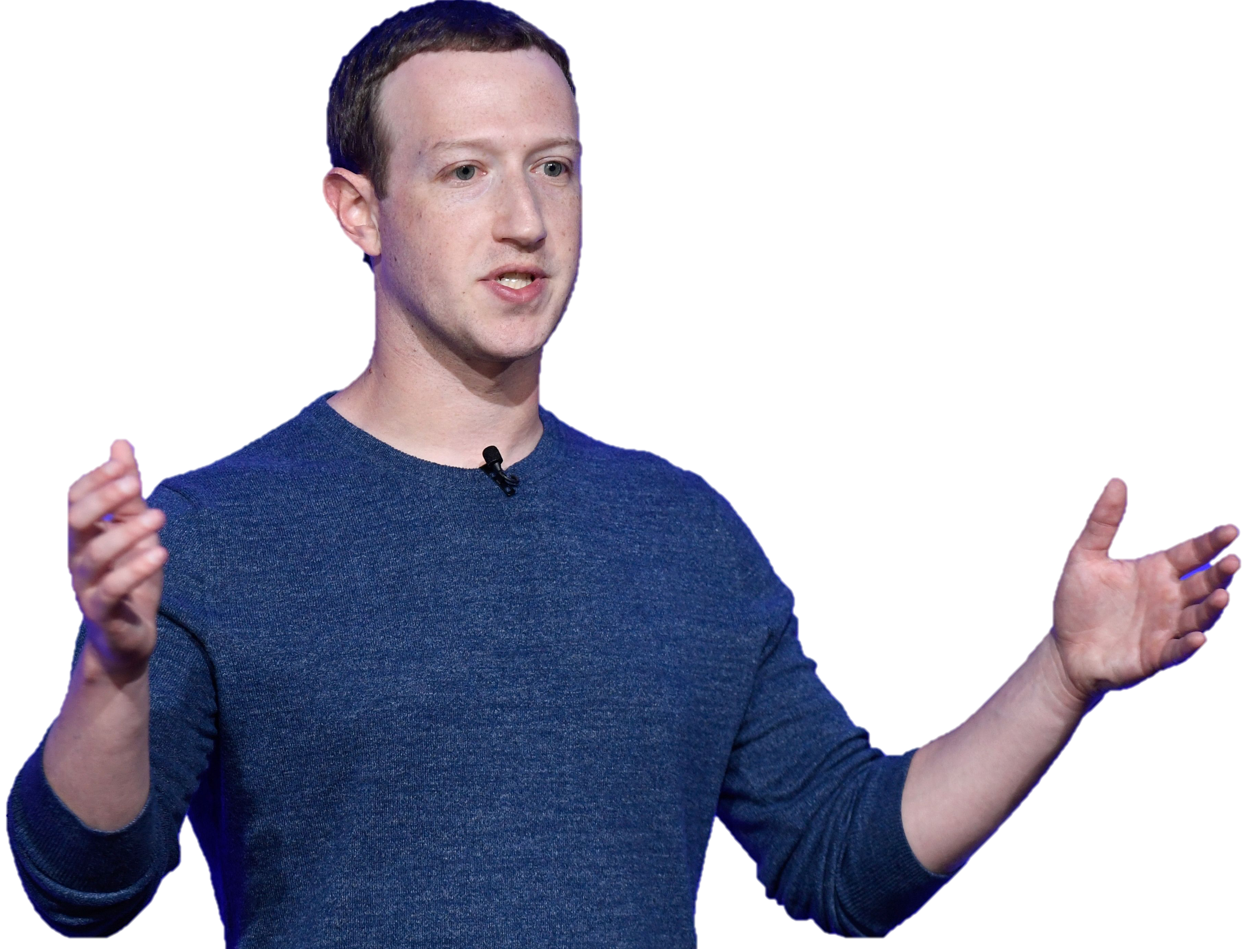
Right to object v Right to erasure?
Processing operation v personal data
Improve the Service
Promote safety, integrity and security.
Provide the Service
provide advertisers with reports
Communicate with you.
Provide measurement, analytics and other business services
Research and innovate for social good
Personalise the Service
Notes:
R2O often confused with R2E.
Added value of R2O = granularity / surgicality

Slide 49
Virtual assistant
IoEverything
Advertising
WoolHowMuchAreYouWorths
Supermarket
A smart fridge
Insurance HealthTrendFollower
Notes:
Where does R2O apply?
What actions need to be taken to enable this?
Conflict with other rights/freedoms/interests?
Espescially regarding insurance provider => point out limits of data protection. Consumer protection more appropriate legal framework => Damian.

Slide 50
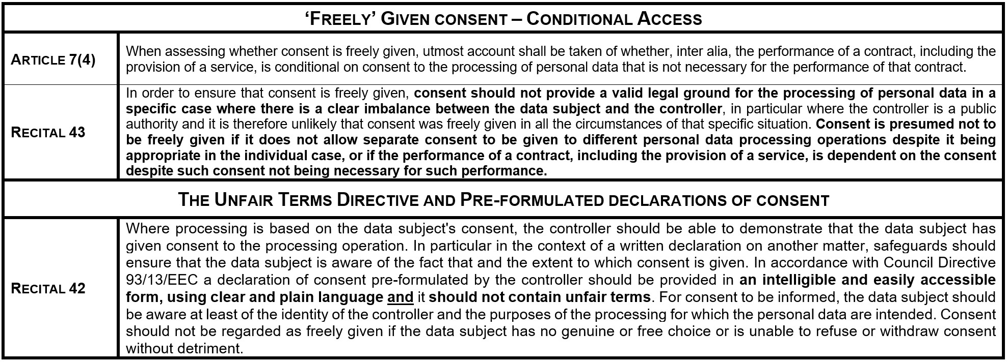

Slide 51
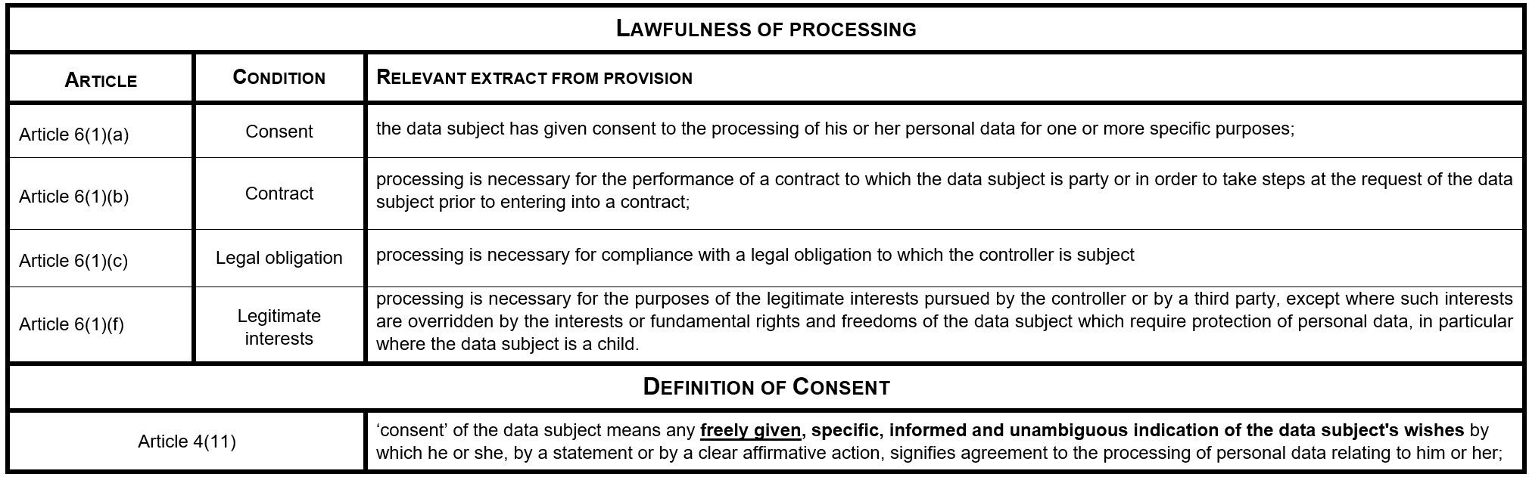

Slide 52
Key Provisions from the GDPR
Data subject rights and ex post fair balancing – Article 21 GDPR The right to object in focus
‘The data subject shall have the right to object, on grounds relating to his or her particular situation, at any time to processing of personal data concerning him or her which is based on point (e) or (f) of Article 6(1), including profiling based on those provisions. The controller shall no longer process the personal data unless the controller demonstrates compelling legitimate grounds for the processing which override the interests, rights and freedoms of the data subject or for the establishment, exercise or defence of legal claims.’
Article 6(1)(e-f) – refer to ‘interests’. More generic situation in Article 6(1)(e-f)?
Balancing stress test triggered by ex post empowerment measures directly implicates the enjoyment of a fundamental right. Any refusal of the rights to erasure, object, or not to be subject to automated decision-making justified by a legislative measure in light of Article 52(1).

Slide 53
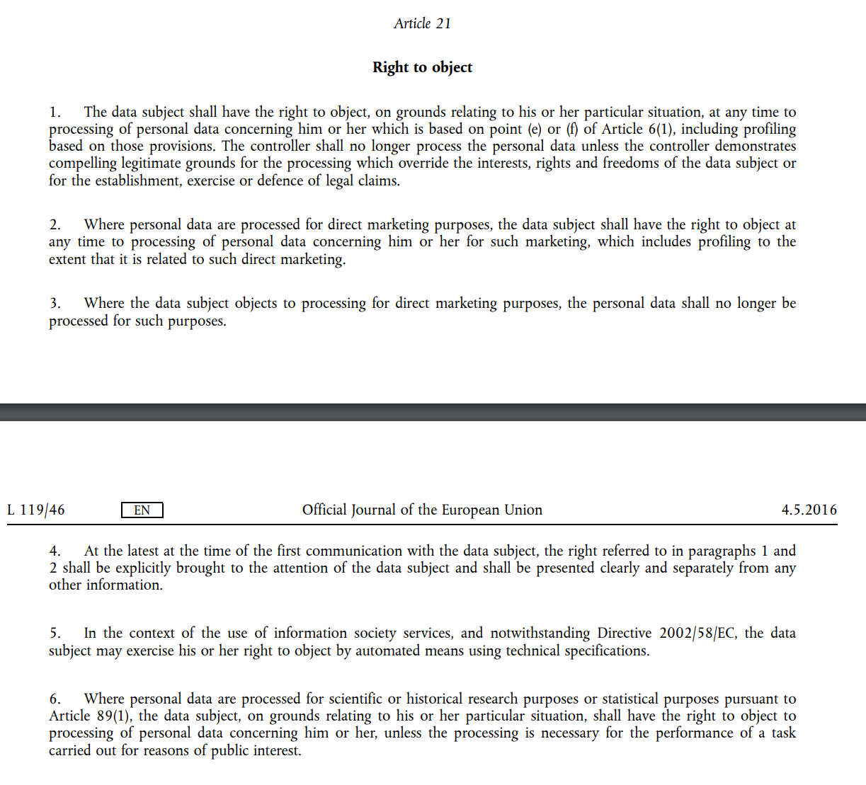

Slide 54
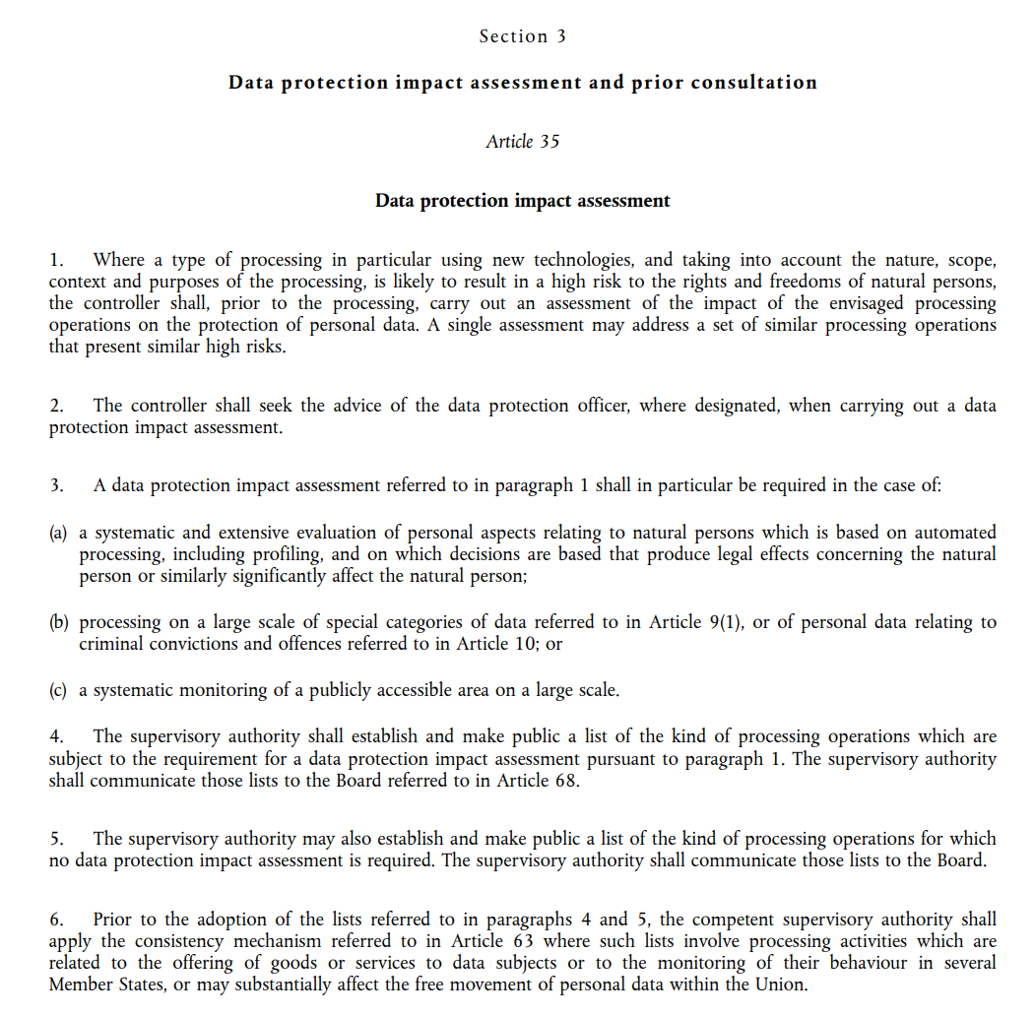
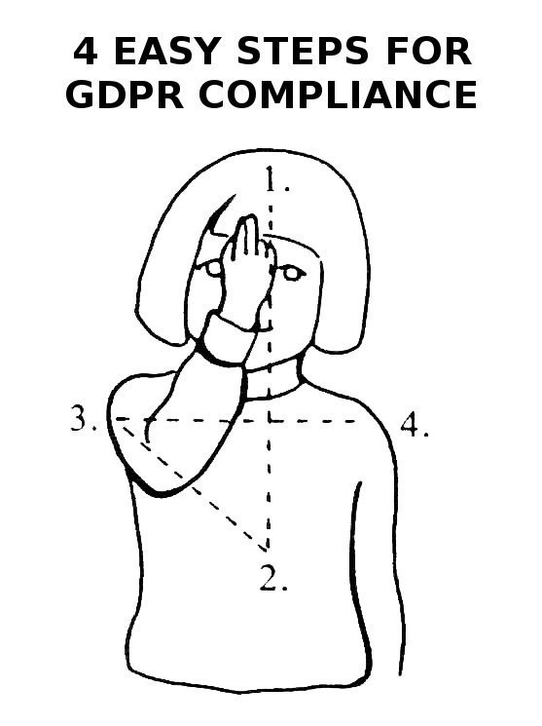
1. Accountability Principle
2. Risk-based approach
3. Uncertainty – e.g. who is the data subject?
Notes:
As fairness plays such an important role there are potential uncertainties everywhere in terms of application. One could say that much is mitigated by the fact that there’s the requirement for a DPIA but then that’s debatable due to the fact that it is an accountability and risk-based framework. It all then links to the idea that there have been moves towards adding more certainty.

Slide 55
4. Fairness versus Unfairness – Consumer and Data Protection law and the divergences in the regulation of unfairness

Slide 57
Consent and the GDPR’s legislative ‘fixes’
Clear attempts to improve status quo in Article 7 GDPR
Rational and autonomous agent fallacy (i.e. with appropriate information see Articles 7(3), 13, 14 GDPR)
Recital 42 GDPR – UCT Directive: Differences here? What are the ‘core’ terms? i.e. what is excluded from the substantive unfairness test?

Slide 58
Consent and the GDPR’s legislative ‘fixes’
Fairness and the UCT Directive
Unfair Terms Directive
Differences here? What are the ‘core’ terms? i.e. what is excluded from the substantive fairness test?
Substantive
Formal

Slide 59
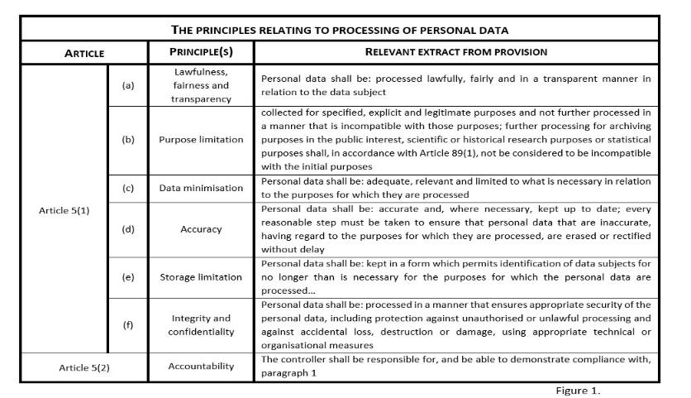
Consent and the GDPR’s Legislative ‘Fixes’
(Un)Fairness and the UCT Directive
Unfair Terms Directive
Fairness and the GDPR – Differences here? What are the ‘core’ terms? i.e. what is excluded from the substantive (un)fairness test in Article 4(2) UCT Directive?
Substantive (Art. 3(1)‘good faith’ ‘significant imbalance’
Formal (Art. 5 – ‘plain, intelligible language’ and the in dubio contra proferentem rule )
‘[A]ssessment of the unfair nature of the terms shall relate neither to the definition of the main subject matter of the contract nor to the adequacy of the price and remuneration, on the one hand, as against the services or goods supplies [sic] in exchange, on the other, in so far as these terms are in plain intelligible language.’

Slide 60
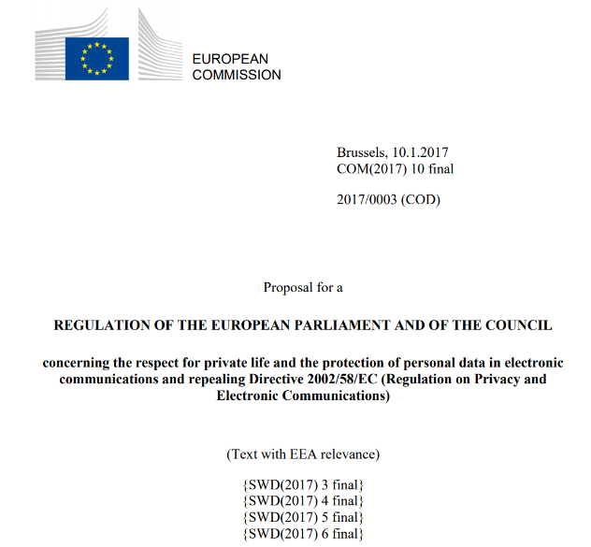
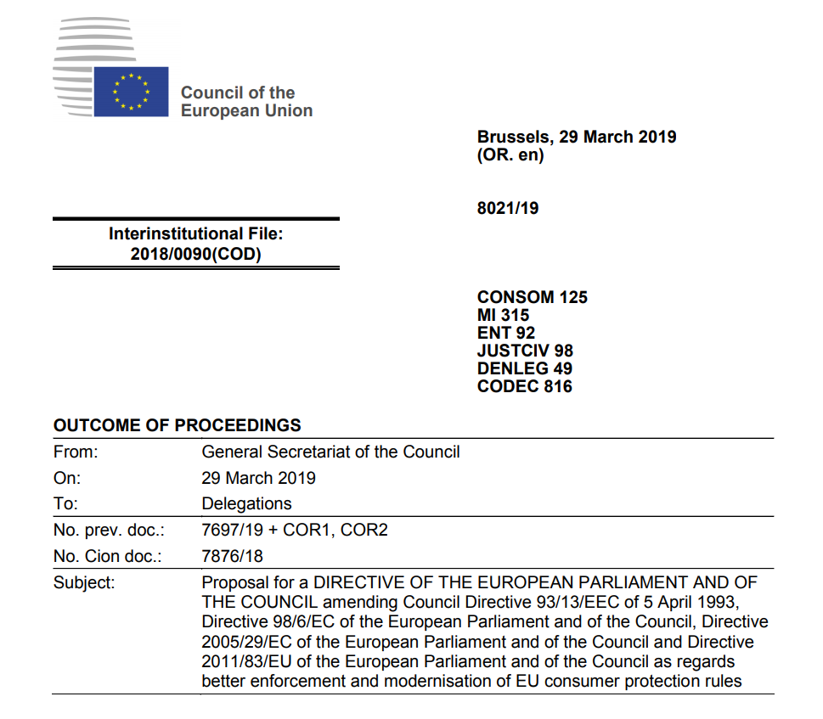
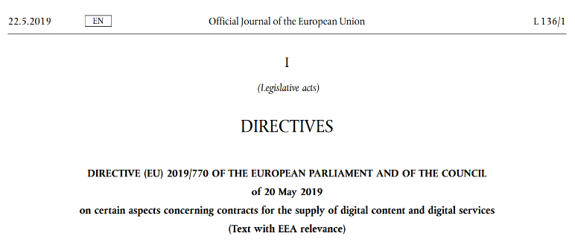
Illustrating Uncertainty in Policy Making

Slide 61


Illustrating Uncertainty (1) – Proposed ePrivacy Regulation
Notes:
Cookie notice failure

Slide 62
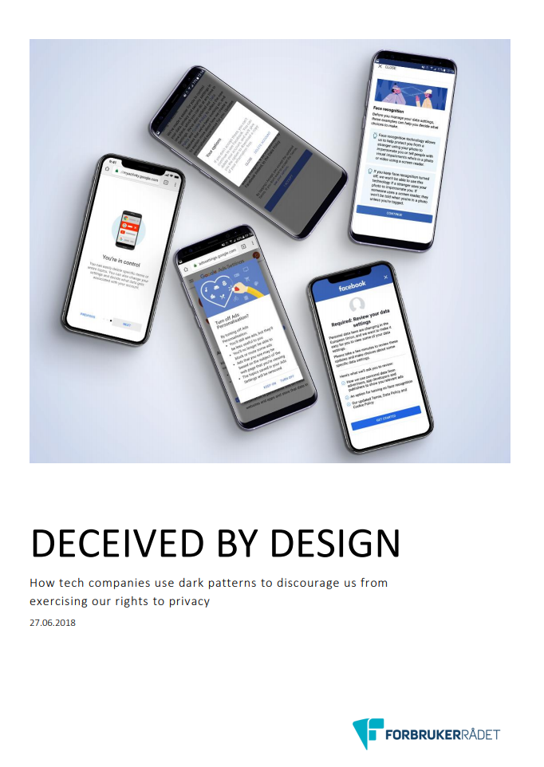

Notes:
Data Visceralisation
UX UI design, dark patterns etc.
Data protection by default and by design

Slide 63
Illustrating Uncertainty (2) – Digital Content Directive
Article 3(1) Digital Content Directive provides that,
‘[t]his Directive shall apply to any contract where the trader supplies or undertakes to supply digital content or a digital service to the consumer and the consumer pays or undertakes to pay a price. This Directive shall also apply where the trader supplies or undertakes to supply digital content or a digital service to the consumer and the consumer provides or undertakes to provide personal data to the trader, except where the personal data provided by the consumer is exclusively processed by the trader for supplying the digital content or digital service in accordance with this Directive or for the trader to comply with legal requirements to which the trader is subject, and the trader does not process this data for any other purpose.’
Personal data as counter-performance (see original proposal).
For example the Italian Competition and Consumer Protection Authority (AGCM) issued two separate rulings against Facebook following the Facebook/WhatsApp merger one on the unfairness of the terms (UCT Directive) and the second on the unfairness of the practices employed to attain the acceptance of the consumers (Unfair Commercial Practices Directive).

Slide 64
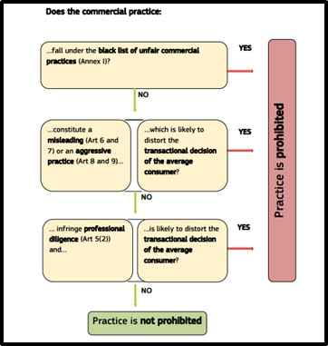
Autonomous decision-making
Unfair Commercial Practices Directive
General clause (Article 5(2) UCPD)
Small general clauses – Misleading and aggressive commercial practices (Article 5(4) UCPD)
Article 5(5) makes reference to Annex I – lists misleading or aggressive trading practices that are deemed de facto unfair Average consumer standard
But why was it the AGCM and not the Italian Data Protection Authority pursuing Facebook?

Slide 65
Uncertain that the GDPR will really cope.
Everything mostly focused on upstream rather than downstream effects.
SO
How it is possible to ensure the ongoing viability of the average consumer standard? How can we create an environment in which consumers can make a rational choice or, more specifically, act in the pursuit of their own goals (i.e. autonomous irrationality)?

Slide 66
Autonomous Decision-Making and Personlisation
Unfair Commercial Practices Directive – The effect of personalisation on the decision-making capacity of individuals?
Aggressive commercial practices ‘by harassment, coercion or undue influence significantly impair the freedom of choice or conduct of the average consumer’
European Commission guidance document on the interpretation of UCP Directive – in certain circumstances ‘personalised pricing/marketing could be combined with unfair commercial practices in breach of the UCPD’ (i.e. Articles 8 and 9 UCP Directive)
Localising the harm – Is it an ex ante or ex post problem? No real clarity but….
Notes:
Data Visceralisation
UX UI design, dark patterns etc.
Data protection by default and by design

Slide 67
Illustrating Uncertainty – Modernisation Directive (Compromise)
Point 11a to Annex I UCP Directive. This new provision blacklists ‘[p]roviding search results in response to a consumer’s online search query without clearly disclosing any paid advertisement or payment specifically for achieving higher ranking of products within the search results.’
Article 6a(1)(a) CR Directive, the operators of online marketplaces are required to provide inter alia,
‘[…] general information made available in a specific section of the online interface that is directly and easily accessible from the page where the offers are presented on the main parameters determining ranking, as defined in point (m) of Article 2(1) of Directive 2005/29/EC, of offers presented to the consumer as result of the search query and the relative importance of those parameters as opposed to other parameters’.
Article 6(1)(ea) CR Directive introduces the requirement to inform the consumer ‘where applicable, that the price was personalised on the basis of automated decision making’.
Notes:
Data Visceralisation
UX UI design, dark patterns etc.
Data protection by default and by design

Slide 68
Do information provision requirements have the capacity to truly protect consumers? If individuals are emotionally manipulated how then in their subjective state can we return them to a point of objectivity within which they would have the capacity to exercise their consumer rights effectively? Is paternalistic intervention necessary? And how do we delineate necessary intervention from paternalistic manipulation of choice?
Notes:
Ethical AI/Machine learning and fairness/Fairness in law/fairness standards in the constitutional framework of the EU (how does this frame things?)

Slide 69
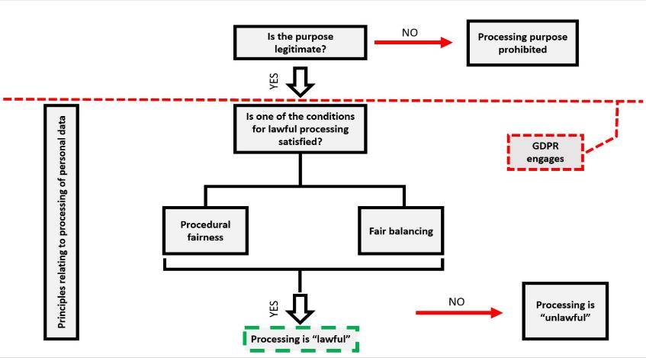
The Blacklisting of Purposes, But Does this Fit with Data Protection or is it Balancing?

Slide 70
Positive Obligations and the Harmonisation of Fundamental Right(s) Standard
Fundamental rights are key in the interpretation of and derogation from EU primary and secondary law.
However, no general EU competence to adopt legislation on the basis of the protection of fundamental rights.
Opinion 2/94 – ‘[n]o Treaty provision confers on the Community institutions any general power to enact rules on human rights or to conclude international conventions in this field.’
BUT through the discussion of the ‘fair balancing’ case law, there is an important distinction between an apparent lack of a general power to legislate and the negative duty not to breach fundamental rights.

Slide 71
Harmonised standards and the division of competence
From a legislative perspective the limits of the EU’s fundamental rights competence will be defined by its policy objectives and the associated competence limits.
But there can be dualist objectives – Think Directive 95/46/EC.
Although some controversy in this regard – Tobacco Advertising cases etc.
EU consumer policy – Consumer protection/Consumer law? And what does this mean for data protection?
Article 16 TFEU – The EU legislator is afforded a specific legislative basis.

Slide 72
4 Key Interpretative Challenges
Personal data, counter-performance, consideration – Real difficulties aligning the dignity-based and economic-based protections. Are these fundamentally conflicting or is there room for both?
The EU Legislator seems to think there’s room for both so….
‘Chicken-and-egg’ and localising the harm – Do the ex ante protections subsume attempts at ex post protection? Can we not just ban certain purposes?
Yes but it may be more complicated than you think
Information obligations, empowerment and paternalism – Do the attempts at mitigating the negative effects of personalisation reflect consumer protection or market goals? Is there a fundamental disconnect between data protection and consumer protection (i.e. fairness versus unfairness)?
Yes but difficult to understand how deep this runs
Fairness, ethics and AI – What is this ‘ethical AI’ debate really about? What is the role for fairness here? What are the limitations for the EU, MSs and substantively?
Who wants a migraine?

Slide 73
5. Conclusion – The limits of the EU law (approach)

